Slide 1
CSE419 – Artificial Intelligence and Machine Learning 2018 PhD Furkan Gözükara, Toros University https://github.com/FurkanGozukara/CSE419_2018
Lecture 14
Unsupervised Learning
Based on Asst. Prof. Dr. David Kauchak (Pomona College) Lecture Slides

Slide 2
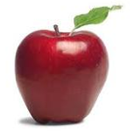
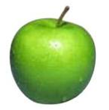
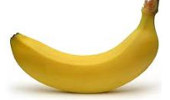
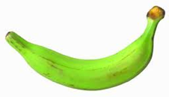
Supervised learning
label
label₁
model/
predictor
label₃
label₄
label₅
Supervised learning: given labeled examples

Slide 3
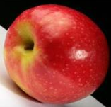
Unsupervised learning
Unupervised learning: given data, i.e. examples, but no labels

Slide 4
Unsupervised learning
Given some example without labels, do something!

Slide 5
Unsupervised learning applications
learn clusters/groups without any label
customer segmentation (i.e. grouping)
image compression
bioinformatics: learn motifs
find important features
…

Slide 6
Unsupervised learning: clustering
Raw data
features
f₁, f₂, f₃, …, f_{n}
f₁, f₂, f₃, …, f_{n}
Clusters
f₁, f₂, f₃, …, f_{n}
f₁, f₂, f₃, …, f_{n}
group into classes/clusters
extract
features
f₁, f₂, f₃, …, f_{n}
No “supervision”, we’re only given data and want to find natural groupings

Slide 7
Unsupervised learning: modeling
Most frequently, when people think of unsupervised learning they think clustering
Another category: learning probabilities/parameters for models without supervision
Learn a translation dictionary
Learn a grammar for a language
Learn the social graph

Slide 8
Clustering
Clustering: the process of grouping a set of objects into classes of similar objects
Applications?

Slide 9
Gene expression data
Data from Garber et al.
PNAS (98), 2001.

Slide 10
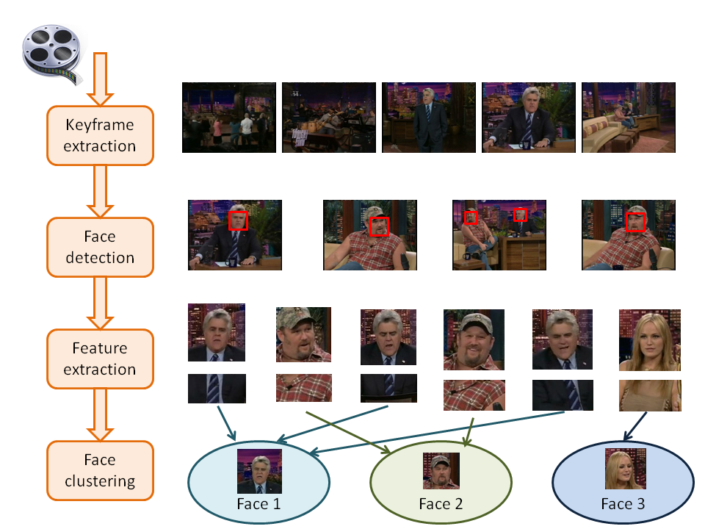
Face Clustering

Slide 11
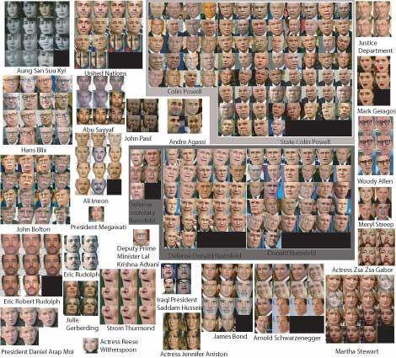
Face clustering

Slide 12
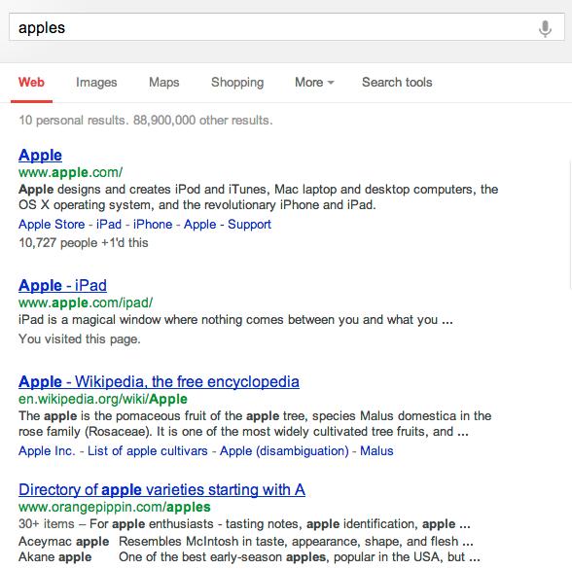
Search result clustering

Slide 13
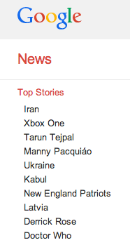
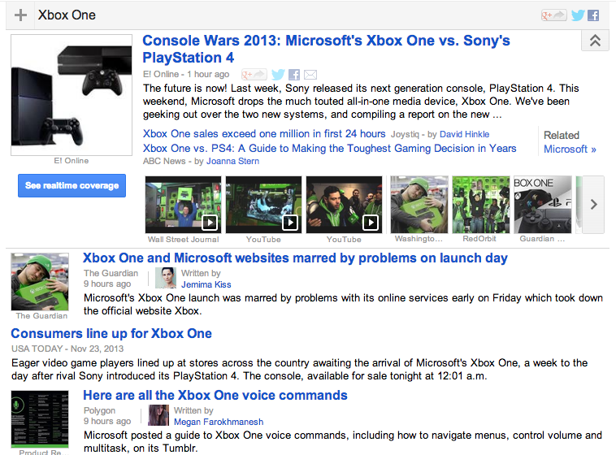
Google News

Slide 14
Clustering in search advertising
Find clusters of advertisers and keywords
Keyword suggestion
Performance estimation
bids
Advertiser
Bidded Keyword
~10M nodes

Slide 15
Clustering applications
Find clusters of users
Targeted advertising
Exploratory analysis
Clusters of the Web Graph
Distributed pagerank computation
Who-messages-who IM/text/twitter graph
~100M nodes

Slide 16
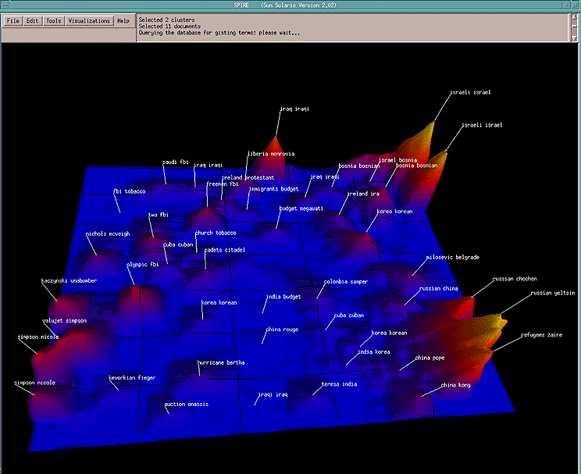
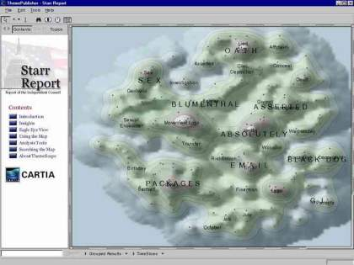
Data visualization
Wise et al, “Visualizing the non-visual” PNNL
ThemeScapes, Cartia
[Mountain height = cluster size]

Slide 17
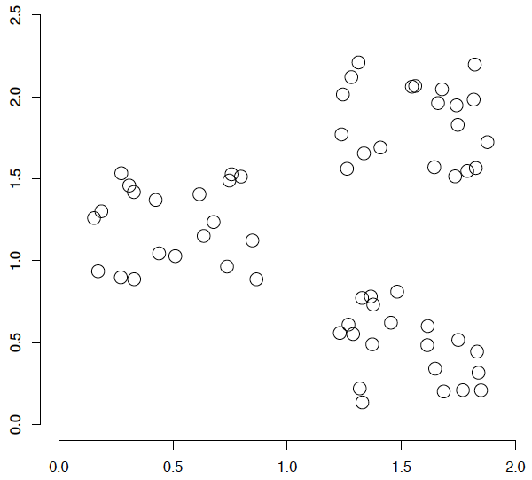
A data set with clear cluster structure
What are some of the issues for clustering?
What clustering algorithms have you seen/used?

Slide 18
Issues for clustering
Representation for clustering
How do we represent an example
features, etc.
Similarity/distance between examples
Flat clustering or hierarchical
Number of clusters
Fixed a priori
Data driven?

Slide 19
Clustering Algorithms
Flat algorithms
Usually start with a random (partial) partitioning
Refine it iteratively
K means clustering
Model based clustering
Spectral clustering
Hierarchical algorithms
Bottom-up, agglomerative
Top-down, divisive

Slide 20
Hard vs. soft clustering
Hard clustering: Each example belongs to exactly one cluster
Soft clustering: An example can belong to more than one cluster (probabilistic)
Makes more sense for applications like creating browsable hierarchies
You may want to put a pair of sneakers in two clusters: (i) sports apparel and (ii) shoes

Slide 21
K-means
Most well-known and popular clustering algorithm:
Start with some initial cluster centers
Iterate:
Assign/cluster each example to closest center
Recalculate centers as the mean of the points in a cluster

Slide 22
K-means: an example

Slide 23
K-means: Initialize centers randomly

Slide 24
K-means: assign points to nearest center

Slide 25
K-means: readjust centers

Slide 26
K-means: assign points to nearest center

Slide 27
K-means: readjust centers

Slide 28
K-means: assign points to nearest center

Slide 29
K-means: readjust centers

Slide 30
K-means: assign points to nearest center
No changes: Done

Slide 31
K-means
Iterate:
Assign/cluster each example to closest center
Recalculate centers as the mean of the points in a cluster
How do we do this?

Slide 32
K-means
Iterate:
Assign/cluster each example to closest center
Recalculate centers as the mean of the points in a cluster
iterate over each point:
- get distance to each cluster center
- assign to closest center (hard cluster)

Slide 33
K-means
Iterate:
Assign/cluster each example to closest center
Recalculate centers as the mean of the points in a cluster
iterate over each point:
- get distance to each cluster center
- assign to closest center (hard cluster)
What distance measure should we use?

Slide 34
Distance measures
Euclidean:
good for spatial data
Notes:
Spatial data, also known as geospatial data, is information about a physical object that can be represented by numerical values in a geographic coordinate system.

Slide 35
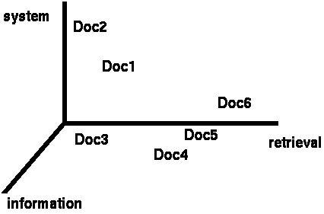
Clustering documents (e.g. news data)
One feature for each word. The value is the number of times that word occurs.
Documents are points or vectors in this space

Slide 36
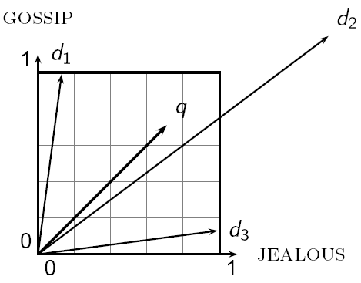
When Euclidean distance doesn’t work
Which document is closest to q using Euclidian distance?
Which do you think should be closer?

Slide 37
Issues with Euclidian distance
the Euclidean distance between q and d₂ is large
but, the distribution of terms in the query q and the distribution of terms in the document d₂ are very similar
This is not what we want!

Slide 38
cosine similarity
correlated with the angle between two vectors

Slide 39
cosine distance
cosine similarity is a similarity between 0 and 1, with things that are similar 1 and not 0
We want a distance measure, cosine distance:
good for text data and many other “real world” data sets
is computationally friendly since we only need to consider features that have non-zero values both examples

Slide 40
K-means
Iterate:
Assign/cluster each example to closest center
Recalculate centers as the mean of the points in a cluster
Where are the cluster centers?

Slide 41
K-means
Iterate:
Assign/cluster each example to closest center
Recalculate centers as the mean of the points in a cluster
How do we calculate these?

Slide 42
K-means
Iterate:
Assign/cluster each example to closest center
Recalculate centers as the mean of the points in a cluster
Mean of the points in the cluster:
where:

Slide 43
K-means loss function
K-means tries to minimize what is called the “k-means” loss function:
that is, the sum of the squared distances from each point to the associated cluster center

Slide 44
Minimizing k-means loss
Iterate:
1. Assign/cluster each example to closest center
2. Recalculate centers as the mean of the points in a cluster
Does each step of k-means move towards reducing this loss function (or at least not increasing)?

Slide 45
Minimizing k-means loss
Iterate:
1. Assign/cluster each example to closest center
2. Recalculate centers as the mean of the points in a cluster
This isn’t quite a complete proof/argument, but:
Any other assignment would end up in a larger loss
The mean of a set of values minimizes the squared error

Slide 46
Minimizing k-means loss
Iterate:
1. Assign/cluster each example to closest center
2. Recalculate centers as the mean of the points in a cluster
Does this mean that k-means will always find the minimum loss/clustering?

Slide 47
Minimizing k-means loss
Iterate:
1. Assign/cluster each example to closest center
2. Recalculate centers as the mean of the points in a cluster
NO! It will find a minimum.
Unfortunately, the k-means loss function is generally not convex and for most problems has many, many minima
We’re only guaranteed to find one of them

Slide 48
K-means variations/parameters
Start with some initial cluster centers
Iterate:
Assign/cluster each example to closest center
Recalculate centers as the mean of the points in a cluster
What are some other variations/parameters we haven’t specified?

Slide 49
K-means variations/parameters
Initial (seed) cluster centers
Convergence
A fixed number of iterations
partitions unchanged
Cluster centers don’t change
K!

Slide 50
K-means: Initialize centers randomly
What would happen here?
Seed selection ideas?

Slide 51
Seed choice
Results can vary drastically based on random seed selection
Some seeds can result in poor convergence rate, or convergence to sub-optimal clusterings
Common heuristics
Random centers in the space
Randomly pick examples
Points least similar to any existing center (furthest centers heuristic)
Try out multiple starting points
Initialize with the results of another clustering method

Slide 52
Furthest centers heuristic
μ₁ = pick random point
for i = 2 to K:
μ_{i} = point that is furthest from any previous centers
point with the largest distance to any previous center
smallest distance from x to any previous center

Slide 53
K-means: Initialize furthest from centers
Pick a random point for the first center

Slide 54
K-means: Initialize furthest from centers
What point will be chosen next?

Slide 55
K-means: Initialize furthest from centers
Furthest point from center
What point will be chosen next?

Slide 56
K-means: Initialize furthest from centers
Furthest point from center
What point will be chosen next?

Slide 57
K-means: Initialize furthest from centers
Furthest point from center
Any issues/concerns with this approach?

Slide 58
Furthest points concerns
If k = 4, which points will get chosen?

Slide 59
Furthest points concerns
If we do a number of trials, will we get different centers?
Notes:
yes and no
we will get different centers, but the three outliers will always get chosen!

Slide 60
Furthest points concerns
Doesn’t deal well with outliers

Slide 61
K-means++
μ₁ = pick random point
for k = 2 to K:
for i = 1 to N:
s_{i} = min d(x_{i}, μ_{1…k-1}) // smallest distance to any center
μ_{k} = randomly pick point proportionate to s
How does this help?

Slide 62
K-means++
μ₁ = pick random point
for k = 2 to K:
for i = 1 to N:
s_{i} = min d(x_{i}, μ_{1…k-1}) // smallest distance to any center
μ_{k} = randomly pick point proportionate to s
Makes it possible to select other points
if #points >> #outliers, we will pick good points
Makes it non-deterministic, which will help with random runs
Nice theoretical guarantees!

Slide 63
Scalable K-Means++
Scalable K-Means++ > http://web.stanford.edu/group/mmds/slides2012/s-bahmani.pdf
K-Means Data Clustering Using C# > https://visualstudiomagazine.com/Articles/2013/12/01/K-Means-Data-Clustering-Using-C.aspx?Page=1
Test Run - K-Means++ Data Clustering > https://msdn.microsoft.com/en-us/magazine/mt185575.aspx

Slide 64
K-means variations/parameters
Initial (seed) cluster centers
Convergence
A fixed number of iterations
partitions unchanged
Cluster centers don’t change
K!

Slide 65
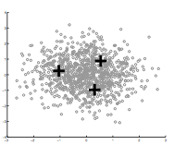
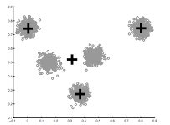
How Many Clusters?
Number of clusters K must be provided
How should we determine the number of clusters?
How did we deal with models becoming too complicated previously?
too many
too few

Slide 66
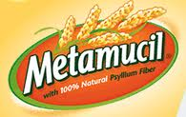
Many approaches
Regularization!!!
Statistical test

Slide 67
k-means loss revisited
K-means is trying to minimize:
What happens when k increases?

Slide 68
k-means loss revisited
K-means is trying to minimize:
Loss goes down!
Making the model more complicated allows us more flexibility, but can “overfit” to the data

Slide 69
k-means loss revisited
K-means is trying to minimize:
(where N = number of points)
2 regularization options
What effect will this have? Which will tend to produce smaller k?

Slide 70
k-means loss revisited
(where N = number of points)
2 regularization options
AIC penalizes increases in K more harshly
Both require a change to the K-means algorithm
Tend to work reasonably well in practice if you don’t know K

Slide 71
Statistical approach
Assume data is Gaussian (i.e. spherical)
Test for this
Testing in high dimensions doesn’t work well
Testing in lower dimensions does work well
ideas?

Slide 72
Project to one dimension and check
For each cluster, project down to one dimension
Use a statistical test to see if the data is Gaussian

Slide 73
Project to one dimension and check
For each cluster, project down to one dimension
Use a statistical test to see if the data is Gaussian
What will this look like projected to 1-D?

Slide 74
Project to one dimension and check
For each cluster, project down to one dimension
Use a statistical test to see if the data is Gaussian

Slide 75
Project to one dimension and check
For each cluster, project down to one dimension
Use a statistical test to see if the data is Gaussian
What will this look like projected to 1-D?

Slide 76
Project to one dimension and check
For each cluster, project down to one dimension
Use a statistical test to see if the data is Gaussian

Slide 77
Project to one dimension and check
For each cluster, project down to one dimension
Use a statistical test to see if the data is Gaussian
What will this look like projected to 1-D?

Slide 78
Project to one dimension and check
For each cluster, project down to one dimension
Use a statistical test to see if the data is Gaussian
Solution?

Slide 79
Project to one dimension and check
For each cluster, project down to one dimension
Use a statistical test to see if the data is Gaussian
Chose the dimension of the projection as the dimension with highest variance

Slide 80
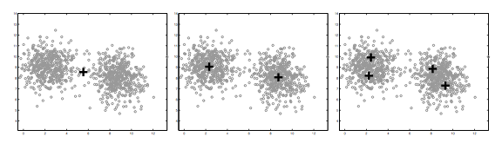
On synthetic data
Split too far

Slide 81
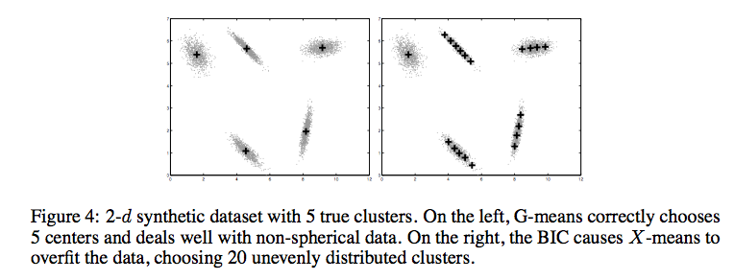
Compared to other approaches
http://cs.baylor.edu/~hamerly/papers/nips_03.pdf

Slide 82
K-Means time complexity
Variables: K clusters, n data points, m features/dimensions, I iterations
What is the runtime complexity?
Computing distance between two points (e.g. euclidean)
Reassigning clusters
Computing new centers
Iterate…

Slide 83
K-Means time complexity
Variables: K clusters, n data points, m features/dimensions, I iterations
What is the runtime complexity?
Computing distance between two points is O(m) where m is the dimensionality of the vectors/number of features.
Reassigning clusters: O(Kn) distance computations, or O(Knm)
Computing centroids: Each points gets added once to some centroid: O(nm)
Assume these two steps are each done once for I iterations: O(Iknm)
In practice, K-means converges quickly and is fairly fast

Slide 84
What Is A Good Clustering?
Internal criterion: A good clustering will produce high quality clusters in which:
the intra-class (that is, intra-cluster) similarity is high
the inter-class similarity is low
How would you evaluate clustering?

Slide 85
Common approach: use labeled data
Use data with known classes
For example, document classification data
data
label
If we clustered this data (ignoring labels) what would we like to see?
Reproduces class partitions
How can we quantify this?

Slide 86
Common approach: use labeled data
Purity, the proportion of the dominant class in the cluster
• •
• •
• •
• •
• •
• •
• •
•
Cluster I
Cluster II
Cluster III
Cluster I: Purity = 1/4 (max(3, 1, 0)) = 3/4
Cluster II: Purity = 1/6 (max(1, 4, 1)) = 4/6
Overall purity?
Cluster III: Purity = 1/5 (max(2, 0, 3)) = 3/5

Slide 87
Overall purity
Cluster I: Purity = 1/4 (max(3, 1, 0)) = 3/4
Cluster II: Purity = 1/6 (max(1, 4, 1)) = 4/6
Cluster III: Purity = 1/5 (max(2, 0, 3)) = 3/5
Cluster average:
Weighted average:

Slide 88
Purity issues…
Purity, the proportion of the dominant class in the cluster
Good for comparing two algorithms, but not understanding how well a single algorithm is doing, why?
Increasing the number of clusters increases purity

Slide 89
Purity isn’t perfect
Which is better based on purity?
Which do you think is better?
Ideas?

Slide 90
Common approach: use labeled data
Average entropy of classes in clusters
where p(class_{i}) is proportion of class i in cluster

Slide 91
Common approach: use labeled data
Average entropy of classes in clusters
entropy?

Slide 92
Common approach: use labeled data
Average entropy of classes in clusters

Slide 93
Problems with K-means
Determining K is challenging
Spherical assumption about the data (distance to cluster center)
Hard clustering isn’t always right
Greedy approach

Slide 94
Problems with K-means
What would K-means give us here?

Slide 95
Assumes spherical clusters
k-means assumes spherical clusters!

Slide 96
K-means: another view

Slide 97
K-means: another view

Slide 98
K-means: assign points to nearest center

Slide 99
K-means: readjust centers
Iteratively learning a collection of spherical clusters

Slide 100
Expectation Maximization (EM) clustering: mixtures of Gaussians
Assume data came from a mixture of Gaussians (elliptical data), assign data to cluster with a certain probability
k-means
EM

Slide 101
EM clustering
Very similar at a high-level to K-means
Iterate between assigning points and recalculating cluster centers
Two main differences between K-means and EM clustering:
We assume elliptical clusters (instead of spherical)
It is a “soft” clustering algorithm

Slide 102
Soft clustering
p(red) = 0.8
p(blue) = 0.2
p(red) = 0.9
p(blue) = 0.1

Slide 103
EM clustering
Start with some initial cluster centers
Iterate:
soft assigned points to each cluster
recalculate the cluster centers
Calculate: p(θ_{c}| x)
the probability of each point belonging to each cluster
Calculate new cluster parameters, θ_{c}
maximum likelihood cluster centers given the current soft clustering

Slide 104
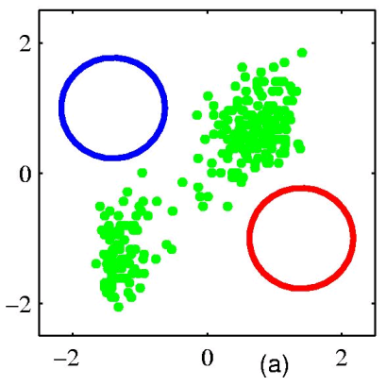
EM example
Start with some initial cluster centers
Figure from Chris Bishop

Slide 105
Step 1: soft cluster points
Which points belong to which clusters (soft)?
Figure from Chris Bishop

Slide 106
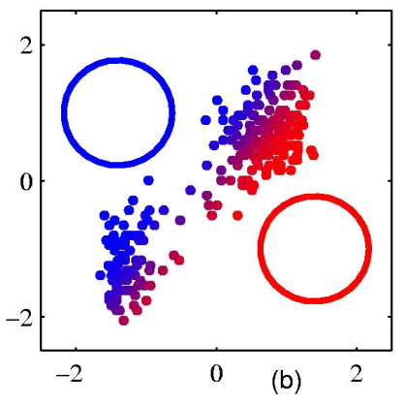
Step 1: soft cluster points
Notice it’s a soft (probabilistic) assignment
Figure from Chris Bishop

Slide 107
Step 2: recalculate centers
What do the new centers look like?
Figure from Chris Bishop

Slide 108
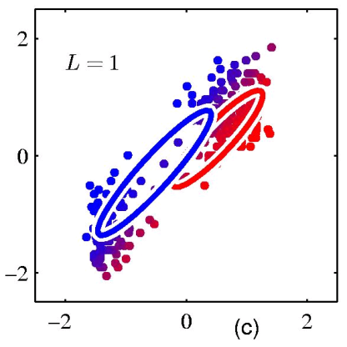
Step 2: recalculate centers
Cluster centers get a weighted contribution from points
Figure from Chris Bishop

Slide 109
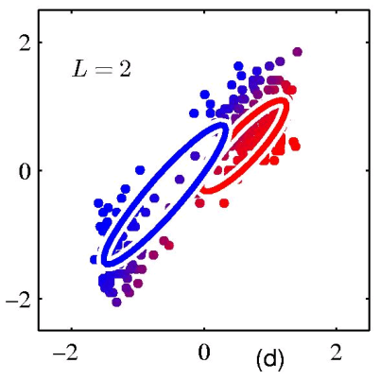
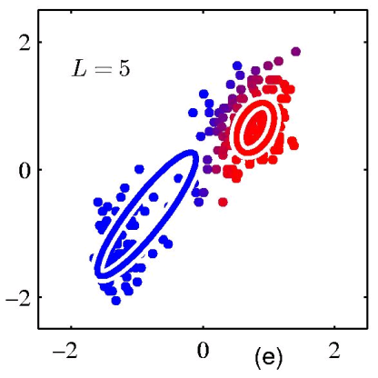
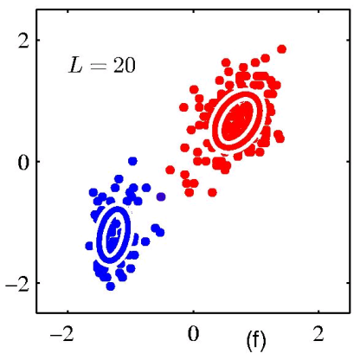
keep iterating…
Figure from Chris Bishop

Slide 110
Model: mixture of Gaussians
How do you define a Gaussian (i.e. ellipse)?
In 1-D?
In M-D?

Slide 111
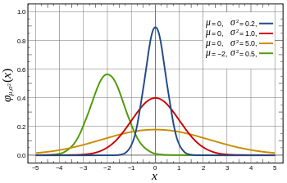
Gaussian in 1D
parameterized by the mean and the standard deviation/variance

Slide 112
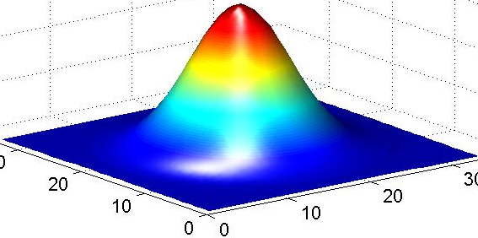
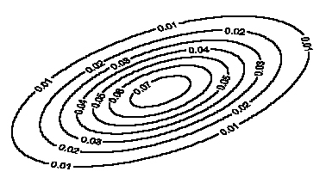
Gaussian in multiple dimensions
Covariance determines
the shape of these contours
We learn the means of each cluster (i.e. the center) and the covariance matrix (i.e. how spread out it is in any given direction)

Slide 113
Step 1: soft cluster points
soft assigned points to each cluster
Calculate: p(θ_{c}|x)
the probability of each point belonging to each cluster
How do we calculate these probabilities?

Slide 114
Step 1: soft cluster points
soft assigned points to each cluster
Calculate: p(θ_{c}|x)
the probability of each point belonging to each cluster
Just plug into the Gaussian equation for each cluster!
(and normalize to make a probability)

Slide 115
Step 2: recalculate centers
Recalculate centers:
calculate new cluster parameters, θ_{c}
maximum likelihood cluster centers given the current soft clustering
How do calculate the cluster centers?

Slide 116
Fitting a Gaussian
What is the “best”-fit Gaussian for this data?
10, 10, 10, 9, 9, 8, 11, 7, 6, …
Recall this is the 1-D Gaussian equation:

Slide 117
Fitting a Gaussian
What is the “best”-fit Gaussian for this data?
10, 10, 10, 9, 9, 8, 11, 7, 6, …
The MLE is just the mean and variance of the data!
Recall this is the 1-D Gaussian equation:

Slide 118
Step 2: recalculate centers
Recalculate centers:
Calculate θ_{c}
maximum likelihood cluster centers given the current soft clustering
How do we deal with “soft” data points?

Slide 119
Step 2: recalculate centers
Recalculate centers:
Calculate θ_{c}
maximum likelihood cluster centers given the current soft clustering
Use fractional counts!

Slide 120
E and M steps: creating a better model
EM stands for Expectation Maximization
Expectation: Given the current model, figure out the expected probabilities of the data points to each cluster
p(θ_{c}|x)
What is the probability of each point belonging to each cluster?
Maximization: Given the probabilistic assignment of all the points, estimate a new model, θ_{c}
Just like NB maximum likelihood estimation, except we use fractional counts instead of whole counts

Slide 121
Similar to k-means
Iterate:
Assign/cluster each point to closest center
Recalculate centers as the mean of the points in a cluster
Expectation: Given the current model, figure out the expected probabilities of the points to each cluster
p(θ_{c}|x)
Maximization: Given the probabilistic assignment of all the points, estimate a new model, θ_{c}

Slide 122
E and M steps
Expectation: Given the current model, figure out the expected probabilities of the data points to each cluster
Maximization: Given the probabilistic assignment of all the points, estimate a new model, θ_{c}
Iterate:
each iterations increases the likelihood of the data and guaranteed to converge (though to a local optimum)!

Slide 123
EM
EM is a general purpose approach for training a model when you don’t have labels
Not just for clustering!
K-means is just for clustering
One of the most general purpose unsupervised approaches
can be hard to get right!

Slide 124
EM is a general framework
Create an initial model, θ’
Arbitrarily, randomly, or with a small set of training examples
Use the model θ’ to obtain another model θ such that
Σ_{i} log P_{θ}(data_{i}) > Σ_{i} log P_{θ’}(data_{i})
Let θ’ = θ and repeat the above step until reaching a local maximum
Guaranteed to find a better model after each iteration
i.e. better models data
(increased log likelihood)
Where else have you seen EM?

Slide 125
EM shows up all over the place
Training HMMs (Baum-Welch algorithm)
Learning probabilities for Bayesian networks
EM-clustering
Learning word alignments for language translation
Learning Twitter friend network
Genetics
Finance
Anytime you have a model and unlabeled data!

Slide 126
Other clustering algorithms
K-means and EM-clustering are by far the most popular for clustering
However, they can’t handle all clustering tasks
What types of clustering problems can’t they handle?

Slide 127
Non-gaussian data
What is the problem?
Similar to classification: global decision (linear model) vs. local decision (K-NN)
Spectral clustering

Slide 128
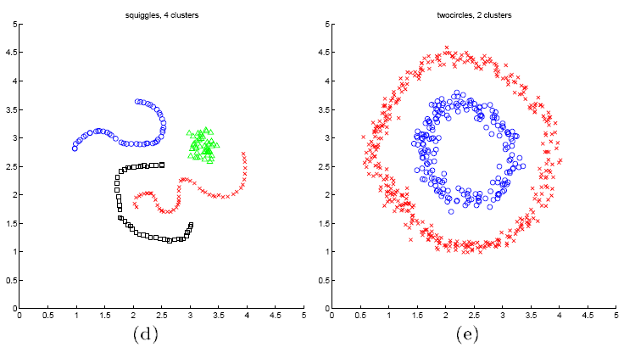
Spectral clustering examples
Ng et al On Spectral clustering: analysis and algorithm

Slide 129
Spectral clustering examples
Ng et al On Spectral clustering: analysis and algorithm

Slide 130
Spectral clustering examples
Ng et al On Spectral clustering: analysis and algorithm

